Slide 1

Fahad M Almajid.MD
Associate Professor of
Infectious diseases
1436

Slide 2
What is Pneumonia?
Pneumonia
is an an acute infection of the pulmonary parenchyma .
alveolar infection leading to consolidation of the greater part or one or more lobes,. resulting in
alveolar filling with fluid causing Air space disease (consolidation and exudation).
It is a common and potentially serious illness with considerable morbidity and mortality, particularly in :
1) Older adult patients .
2) Patients with significant comorbidities.

Slide 3
CLASSIFICATION
Practical classification
  Community Acquired Pneumonia (CAP)
  Hospital Acquired Pneumonia (HAP)
    Ventilator Associated Pneumonia (VAP)
    Health Care Associate Pneumonia (HCAP)
  Aspiration Pneumonia
  Pneumonia in the Immunocompromised Patients

Slide 4
Pneumonia: Definitions
  Community Acquired Pneumonia (CAP)
Infection is acquired in the community.
  Hospital Acquired Pneumonia (HAP)
  Pneumonia > 48 hours after admission which was not
  incubating at the time of admission.
  A) Ventilator Associated Pneumonia (VAP) pneumonia > 48 hours after intubation.
    B) Health Care Associate Pneumonia (HCAP)

Slide 5
Health Care Associate Pneumonia (HCAP)
  Pneumonia that occurs in a nonhospitalized patient with extensive healthcare contact:
Intravenous therapy, wound care, or intravenous chemotherapy within the prior 30 days
Residence in a nursing home or other long-term care facility
Hospitalization in an acute care hospital for two or more days within the prior 90 days
Attendance at a hospital or hemodialysis clinic within the prior 30 days

Slide 6
Pathogenesis
Inhalation,
aspiration and
hematogenous spread
Primary inhalation:
Organisms bypass normal respiratory defense mechanisms or
when the Pt inhales aerobic GN organisms that colonize the upper respiratory tract or respiratory support equipment

Slide 7
Pathogenesis
Aspiration:
when the Pt aspirates colonized upper respiratory tract secretions
  Stomach: reservoir of GNR that can ascend, colonizing the respiratory tract.
Hematogenous:
Originate from a distant source and reach the lungs via the blood stream.

Slide 8
Pathogenesis
Microaspiration
from nasopharynx:
S. Pneumonia
Inhalation:
S. Pneumonia , TB, viruses, Legionella
Aspiration:
anaerobes
Bloodborne:
Staph endocarditis, septic emboli

Slide 9
Community acquired pneumonia
Pathogens
Usually caused by a single organism.
S. pneumoniae is the most common cause of community-acquired pneumonia (CAP),
isolation of the organism in only 5 to 18 percent of cases.
Many culture-negative cases are caused by pneumococcus:
1) sputum culture is negative in about 50 percent of patients with concurrent pneumococcal bacteremia.
2) majority of cases of unknown etiology respond to treatment with penicillin
Caused by a variety of Bacteria, Viruses, Fungi

Slide 10
Pneumococci are acquired by aerosol inhalation, leading to colonization of the nasopharynx.
Colonization is present in 40-50 percent of healthy adults and persists for four to 6 weeks.(carriage is more common in children and smokers )

Slide 11
Risk factors
Influenza infection
Alcohol abuse
Smoking
Hyposplenism or splenectomy
Immunocompromise due to :
a) Multiple myeloma
b) Systemic lupus erythematosus
c) Transplant recipients

Slide 12
Aspiration Pneumonia
Common pathogens
  Mixed flora
  Mouth anaerobes
    Peptostreptococcus spp, Actinomyces spp.
  Stomach contents
    Chemical pneumonitis
    Enterobacterium

Slide 13
TYPICAL
Clinical presentation
Symptomes:
  Sudden onset
  Fever with chills.
  Productive cough, Mucopurulent sputum
  Pleuritic chest pain
  Signs:
  Breath sound: Auscultatory findings of rales and bronchial breath sounds are localized to the involved segment or lobe.

Slide 14
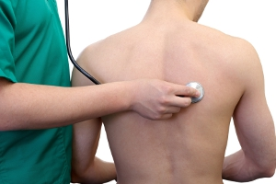
Consolidation is signs:
Dullness on percussion.
Bronchial breath sounds.
Egophony
Whispered pectoriloquy (whispers, are
transmitted clearly ).

Slide 15
Pneumococcal pneumonia may present atypically, especially in older adults where confusion or delirium may be an initial manifestation.

Slide 16
Atypical pneumonia:
Clinical presentation
Atypical
  Gradual onset
  Afebrile
  Dry cough
  Breath sound: Rales
  Uni/bilateral patchy, infiltrates
  WBC: usual normal or slight high
  Sore throat, myalgia, fatigue, diarrhea
  Common etiology
    Mycoplasma pneumoniae
    Chlamydia pneumoniae
    Legionella pneumophilla
    Mycobactria
    Virus

Slide 17
Investigations
CXR :
CBC with diff.
Sputum gram stain, culture susceptibility
Blood Culture
ABG
Urea / Electrolytes

Slide 18
DIAGNOSIS
Chest x ray:
Demonstre infiltrate.
  Establish Dx
  To detect the presence of complications such as :
  pleural effusion (Parapneumonic effusion).
  multilobar diseaseas

Slide 19
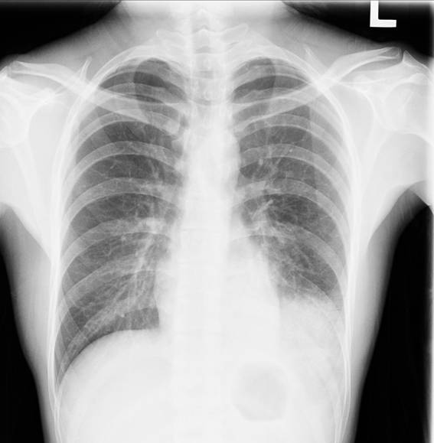
32 Y/O male
Cough for 1 wk
Fever for 2 days
Rales over LLL

Slide 20

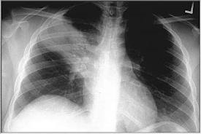
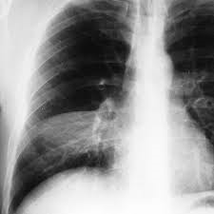

Slide 21
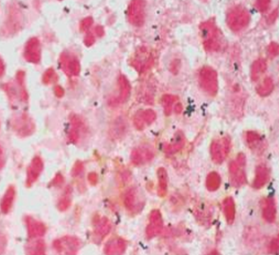
Pneumonia
Diagnosis
  Sputum gram stain and culture
  Good specimen
    PMN’s>25/LPF
    Few epithelial cells<10/LPF
    Single predominant organism

Slide 22
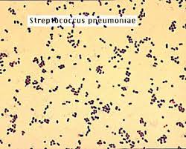
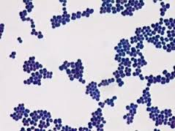
Pneumonia
  Common organisms
    Gram positive: diplococci (pairs and chains)
    Gram positive: clusters, ie staphylococcal pneumonia
    Gram negative: coccobacillary, ie K.P.
    Gram negative: rods
Gram stain
  Organisms not visible on gram stain
    M. pneumonia, Chlamydia
    Legionella pneumophila
    Viruses
    Mycobacterium

Slide 23
Empiric outpt Management in Previously Healthy Pt
No comorbidities, no recent antibiotic use, and low rate of resistance:
Azithromycin – 500 mg on day one followed by four days of 250 mg a day or 500 mg daily for three days
Clarithromycin – 500 mg twice daily for five days
Doxycycline – 100 mg twice daily
IDSA/ATS Guidelines 2007

Slide 24
/
Comorbidities, recent antibiotic use, or high rate of resistance:
A respiratory fluoroquinolone :
levofloxacin 750 mg daily, or
moxifloxacin 400 mg daily, or
gemifloxacin 320 mg daily for five days ….OR

Slide 25
Combination therapy : a beta-lactam AND macrolide.
amoxicillin, 1 g three times daily or
amoxicillin-clavulanate 2 g twice daily
cefuroxime 500 mg twice daily.
Pathogen-directed therapy

Slide 26
Empiric Inpt Management-Medical Ward
Organisms: all of the above plus polymicrobial infections (+/- anaerobes), Legionella
Recommended Parenteral Abx:
  Respiratory fluoroquinolone, OR
  Advanced macrolide plus a beta-lactam
Recent Abx:
  As above. Regimen selected will depend on nature of recent antibiotic therapy.
IDSA/ATS Guidelines 2007

Slide 27
Complications of Pneumonia
Bacteremia
Respiratory and circulatory failure
Pleural effusion (Parapneumonic effusion), empyema, and abscess
  Pleural fluid always needs analysis in setting of pneumonia (do a thoracocentisis)
  needs drainage if empyema develop: Chest tube, surgical

Slide 28
Streptococcus pneumonia
Most common cause of CAP
Gram positive diplococci
Symptoms : malaise, shaking chills, fever, rusty sputum, pleuritic chest pain, cough
Lobar infiltrate on CXR
25% bacteremic

Slide 29
Risk factors for S.pneumonia
Splenectomy (Asplenia)
Sickle cell disease, hematologic diseases
Smoking
Bronchial Asthma and COPD
HIV
ETOH

Slide 30
S. Pneumonia Prevention
Pneumococcal conjugate vaccine (PCV) is a vaccine used to protect infants and young children
  7 serotypes of Streptococcus
Pneumococcal polysaccharide vaccine (PPSV)
  23 serotypes of Streptococcus
PPSV is recommended (routine vaccination) for those over the age of 65

Slide 31
VACCINATION
For both children and adults in special risk categories:
  Serious pulmonary problems, eg. Asthma, COPD
  Serious cardiac conditions, eg., CHF
  Severe Renal problems
  Long term liver disease
  DM requiring medication
  Immunosuppression due to disease (e.g. HIV or SLE) or treatment (e.g. chemotherapy or radio therapy, long-term steroid use
  Asplenia

Slide 32
Haemophilus influenzae
Nonmotile, Gram negative rod
Secondary infection on top of Viral disease, immunosuppression, splecnectomy patients
Encapsulated type b (Hib)
  The capsule allows them to resist phagocytosis and complement-mediated lysis in the nonimmune host
Hib conjugate vaccine

Slide 33
Specific Treatment
Guided by susceptibility testing when available
S. pneumonia:
  β-lactams Cephalosporins, eg Ceftriaxone, Penicillin G
  Macrolides eg.Azithromycin
  Fluoroquinolone (FQ) eg.levofluxacin
  Highly Penicillin Resistant: Vancomycin
H. influenzae:
  Ceftriaxone, Amoxocillin/Clavulinic Acid (Augmentin), FQ, TMP-SMX

Slide 34
CAP: Atypicals
Mycoplasma pneumoniae, Chlamydophila pneumoniae, Legionella; Coxiella burnetii (Q fever), Francisella tularensis (tularemia), Chlamydia psittaci (psittacosis)
Approximately 15% of all CAP
‘Atypical’: not detectable on gram stain; won’t grow on standard media
Notes:
first 3 are NON-zoonotic, last 3 are zoonotic, so ask about animal

Slide 35
ATYPICAL
Unlike bacterial CAP, often extrapulmonary manifestations:
  Mycoplasma: otitis, nonexudative pharyngitis, watery diarrhea, erythema multiforme, increased cold agglutinin titre
  Chlamydophila: laryngitis
Most don’t have a bacterial cell wall→ Don’t respond to β-lactams
Therapy:
macrolides, tetracyclines, quinolones (intracellular penetration, interfere with bacterial protein synthesis)

Slide 36
Remember these associations:
Asplenia: Strep pneumo, H. influ
Alcoholism: Strep pneumo, oral anaerobes, K. pneumo, Acinetobacter, MTB
COPD/smoking: H. influenzae, Pseudomonas, Legionella, Strep pneumo, Moraxella catarrhalis, Chlamydophila pneumoniae
Aspiration: Klebsiella, E. Coli, oral anaerobes

Slide 37
HIV: S. pneumo,
H. influ, P. aeruginosa,
MTB, PCP, Crypto,
Histo, Aspergillus, atypical mycobacteria
Recent hotel, cruise ship: Legionella
Structural lung disease (bronchiectasis): Pseudomonas, Burkholderia cepacia, Staph aureus
ICU, Ventilation: Pseudomonas, Acinetobacter

Slide 38
Pneumonia: Outpatient or Inpatient?
CURB-65
  5 indicators of increased mortality: confusion, BUN >7, RR >30, SBP <90 or DBP <60, age >65
  Mortality: 2 factors→9%, 3 factors→15%, 5 factors→57%
  Score 0-1→outpt. Score 2→inpt. Score >3→ICU.
Pneumonia Severity Index (PSI)
  20 variables including underlying diseases; stratifies pts into 5 classes based on mortality risk
No RCTs comparing CURB-65 and PSI
IDSA/ATS Guidelines 2007

Slide 39
Pneumonia: Medical floor or ICU?
1 major or 3 minor criteria= severe CAP→ICU
Major criteria:
  Invasive ventilation, septic shock on pressors
Minor criteria:
  RR>30; multilobar infiltrates; confusion; BUN >20; WBC <4,000; Platelets <100,000; Temp <36, hypotension requiring aggressive fluids, PaO2/FiO2 <250.
No prospective validation of these criteria
IDSA/ATS Guidelines 2007

Slide 40
CAP Inpatient therapy
General medical floor:
  Respiratory quinolone OR
  IV β-lactam PLUS macrolide (IV or PO)
    β-lactams: cefotaxime, ceftriaxone, ampicillin; ertapenem
    May substitute doxycycline for macrolide (level 3)
ICU:
  β-lactam (ceftriaxone, cefotaxime, Amox-clav) PLUS EITHER quinolone OR azithro
  PCN-allergic: respiratory quinolone PLUS aztreonam
Pseudomonal coverage :
  Antipneumococcal, antipseudomonal β-lactam (pip-tazo, cefepime, imi, mero) PLUS EITHER (cipro or levo) OR (aminoglycoside AND Azithro) OR (aminoglycoside AND respiratory quinolone)
CA-MRSA coverage: Vancomycin or Linezolid
Notes:
all of these regimens cover strep pneumo and cover atypicals

Slide 41
CAP Inpatient Therapy: Pearls
Give 1st dose Antibiotics in ER (no specified time frame)
Switch from IV to oral when pts are hemodynamically stable and clinically improving
Discharge from hospital:
  As soon as clinically stable, off oxygen therapy, no active medical problems
Duration of therapy is usually 7-10 days:
  Treat for a minimum of 5 days
  Before stopping therapy: afebrile for 48-72 hours, hemodynamically stable, RR <24, O2 sat >90%, normal mental status
  Treat longer if initial therapy wasn’t active against identified pathogen; or if complications (lung abscess, empyema)

Slide 42
CAP: Influenza
More common cause in children
  RSV, influenza, parainfluenza
Influenza most important viral cause in adults, especially during winter months
Inhale small aerosolized particles from coughing, sneezing→1-4 day incubation→ ‘uncomplicated influenza’ (fever, myalgia, malaise, rhinitis)→Pneumonia
Adults > 65 account for 63% of annual influenza-associated hospitalizations and 85% of influenza-related deaths
.

Slide 43
CAP: Influenza
Recent worlwide pandemic of H1N1 Influenza A (2009-2010)
Current epidemic in Saudi Arabia (2010-2011)
H1N1 risk factors
  pregnant, obesity, cardipulmonary disease, chronic renal disease, chronic liver disease
CXR findings often subtle, to full blown ARDS
Respiratory (or Droplet) isolation for suspected or documented influenza (Wear mask and gloves)
NP swab for, Rapid Ag test Influ A,B. H1N1 PCR RNA
Current Seasonal Influenza Vaccine prevents disease (given every season)
Bacterial pnemonia (S. pneumo, S. aureus) may follow viral pneumonia

Slide 44
Influenza: Therapy
Neuraminidase inhibitors | Oseltamivir / Tamiflu | 75mg po bid | Influenza A, B
 | Zanamivir / Relenza | 10mg (2 inhalations) BID
Adamantanes | Amantadine / Symmetrel | 100mg po bid | Influenza A
 | Rimantadine / Flumadine | 100mg po qd
H1N1 resistant to Adamantanes
Neuraminidase inhibitors:
  70-90% effective for prophylaxis
  Give within 48h of symptom onset to reduce duration/severity of illness, and viral shedding
  Osteltamivir dose in severe disease 150mg bid

